Slide 1
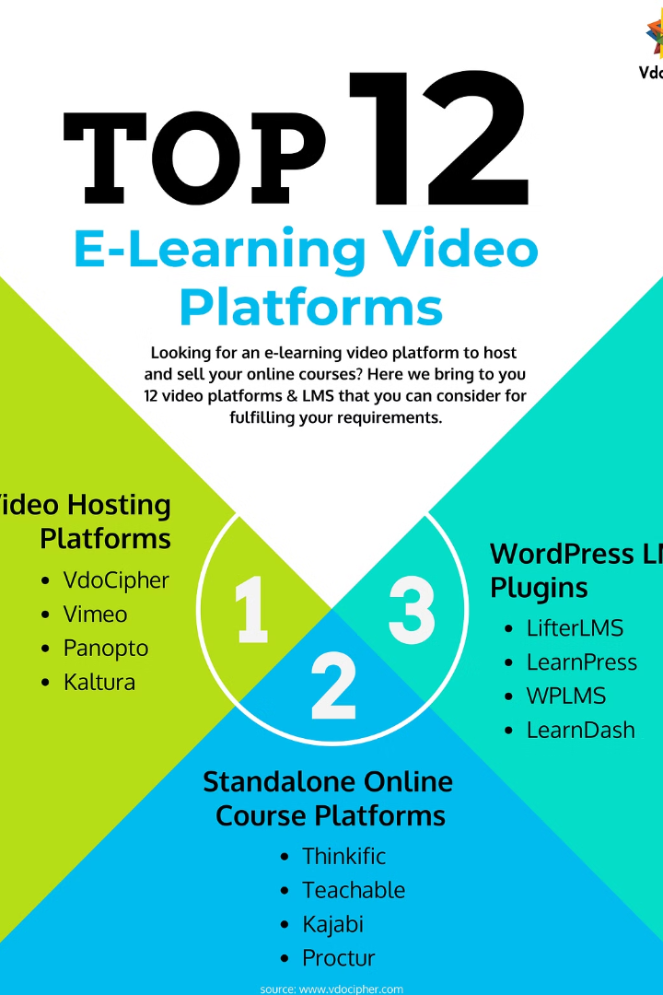


B Learning Website
Discover a self-learning platform with video lectures, study materials, and interactive tests.
by Gokul K Reghu
Athul T V
Jintoraj pt
Franzfrango

Slide 2
Video Lectures
Wide Range of Topics
Expert Instruction
Accessible Anytime
Explore diverse topics through engaging video content.
Learn from experienced educators and professionals.
Access lectures conveniently at your own pace.

Slide 3

Study Materials
1
Comprehensive Resources
2
Visual Aids
Access detailed notes, references, and supplementary materials.
Enhance learning with infographics, charts, and diagrams.
3
Interactive Modules
Engage with interactive tools to reinforce learning concepts.

Slide 4

Interactive Tests
1
Evaluate Knowledge
Assess learning through interactive quizzes and assessments.
2
Receive Feedback
Get instant feedback to track progress and identify areas for improvement.
3
Adaptive Learning
Receive personalized recommendations based on test results.

Slide 5
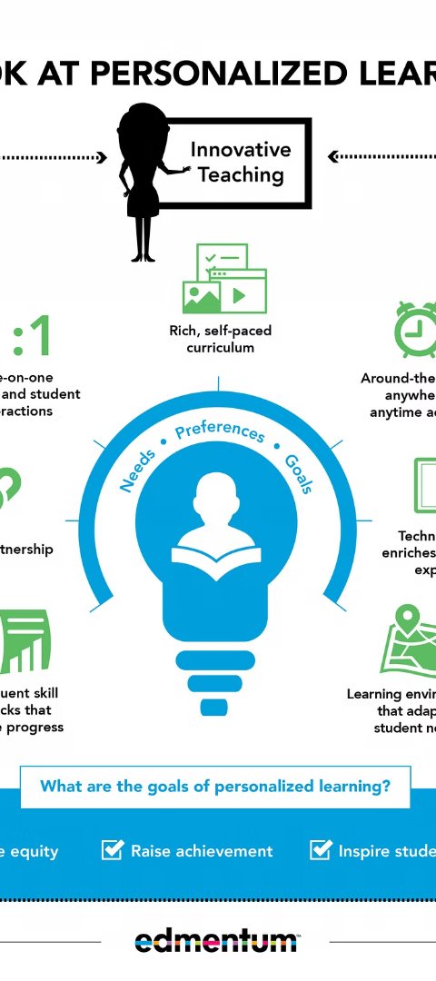
Personalized Learning
Customized Curriculum
Progress Tracking
Personalize your learning path and set individual goals.
Monitor learning milestones and view personalized analytics.
Adaptive Content
Receive tailored content based on learning preferences and progress.

Slide 6



Discussion Forums
Community Interaction
Peer Learning
Q&A Support
Engage in vibrant discussions and knowledge-sharing.
Connect with fellow learners and gain insights from diverse perspectives.
Ask questions and receive help from the learning community.

Slide 7
Additional Resources
1000+
Extensive Library
Access over a thousand resources including articles, papers, and case studies.

Slide 8
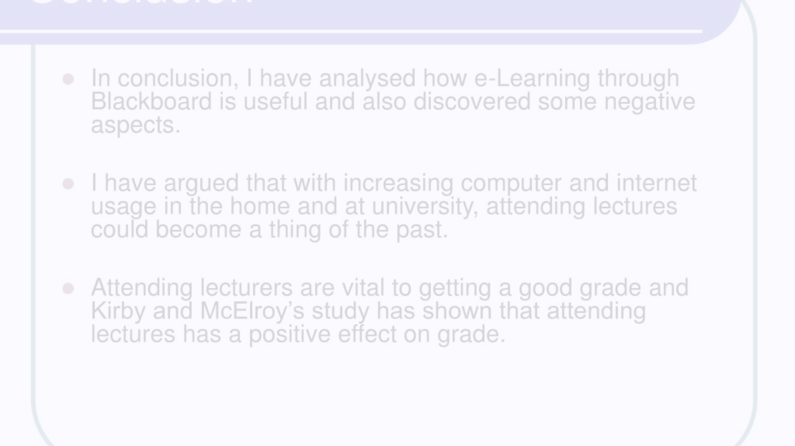



Conclusion & Call to Action
Inspire Learning
Start Today
Continual Growth
Motivate users to embark on their learning journey.
Encourage immediate action to begin the learning experience.
Promote lifelong learning and continuous personal development.

